Slide 1

Northern Technical University
College of Engineering Technology/Mosul
Student Affairs and Registration Division
Welcome to your college, your second home and your launching pad towards building a promising future.
Welcome to the engineers of tomorrow and the change makers your first step towards scientific and technological excellence begins here.
"Our academic journey is completed with your participation. We welcome our dear students to their academic institution and wish them a distinguished academic year."

Slide 2
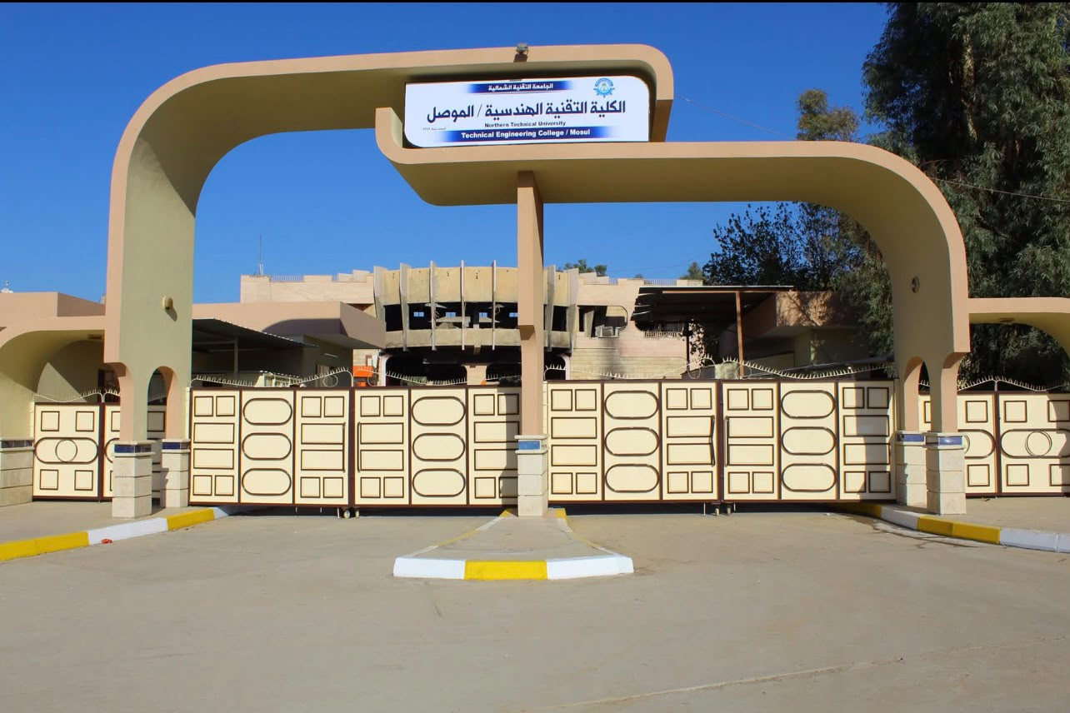
Required documents for registering new students for the academic year 2025-2026
Acceptance of private government education Acceptance of evening studies
General Admission

Slide 3

Documents required for registering students in general government admissions
Original student grade confirmation (copies are not accepted)
(It is accepted until the original document (with the phosphorescent stamp) is brought, otherwise the student's admission to the college will be cancelled)
Medical examination: - Includes
- Eye exam (no copies accepted).
- (CBC) test (no copies accepted).
Received directly (from our college's Higher Education Fund).
Personal photos of the student (6 photos)
A copy of the student's central admission results, published on the ministry's official website.
A colored copy of the student's identification documents (National Unified Card, Residence Card, Ration Card)

Slide 4

Required documents for student registration
Admission to private government education/Evening studies admission
The first installment of tuition fees must be paid (please contact the Higher Education Fund at our college).
(Otherwise, the student will not be registered.)
Medical examination: - Includes
- Eye exam (no copies accepted).
- (CBC) test (no copies accepted).
Received directly (from our college's Higher Education Fund).
Personal photos of the student (6 photos)
A copy of the student's central admission results, published on the ministry's official website.
A colored copy of the student's identification documents (National Unified Card, Residence Card, Ration Card)
A color copy of the student's identification documents (national ID card, residence card, ration card)
Guarantor

